Slide 1
Present-worth Comparisons
Dr. Bidyadhar Padhi

Slide 2
Meaning of Present-worth Comparison
There are different methods to compare engineering proposals like, present worth, Future-worth, equivalent annual worth, Rate of return
Present worth comparison is the most widely used methods for making investment decisions
In engineering economics, when we have two or more alternatives (like machines, projects, or investment options), we need to decide which one is more economical. One of the most widely used methods is the Present Worth (PW) Method.

Slide 3
Meaning of Present Worth
Present Worth (PW) is the equivalent value today (time = 0) of all future cash inflows and outflows, discounted at a given minimum attractive rate of return (MARR).
It converts all costs and benefits to a single value at present time so alternatives can be compared.
Steps for Present Worth Comparison:
List alternatives (e.g., Machine A and Machine B).
Estimate cash flows (initial cost, annual operating cost, salvage value, revenues).
Select MARR (usually given by management).
Calculate PW for each alternative.
Decision Rule:
If revenues are present → choose the alternative with highest PW.
If only costs are present → choose the alternative with least (more negative) PW.

Slide 4
Conditions
Cash flows are given
The interest rate is known.
Purchasing power of money remain constant
Comparisons should be made before taxes.

Slide 5
Selection Criteria
Single Proposal: (independent projects)
PW> 0 (Select the proposal)
PW < 0 (Reject the proposal)
PW = 0 (Indifferent) PW(Revenue) = PW(Cost)
Mutual Exclusive cases:
Mutually Exclusive Projects are alternatives where only one project can be chosen from the set.
Accepting one project automatically rejects the others.
Example: If a company wants to buy a new lathe machine and has 3 models (Machine A, B, and C), it can select only one.
Decision Rule:
If revenues are present → choose the alternative with highest PW.
If only costs are present → choose the alternative with least (more negative) PW.

Slide 6
Single Proposal
1. A company is considering investing in a new CNC machine.
Initial cost = ₹80,000
Annual net cash inflow (savings) = ₹25,000 per year for 5 years
Salvage value at the end of 5 years = ₹10,000
Rate of interest = 12%
Should the company invest in this machine using the Present Worth method?
2. A construction firm is evaluating whether to purchase a concrete mixer.
Initial investment = ₹1,20,000
Annual operating savings = ₹35,000 for 6 years
Salvage value at the end of year 6 = ₹20,000
Rate of Interest = 10%
Using the Present Worth method, determine whether the investment is economically justified.

Slide 7
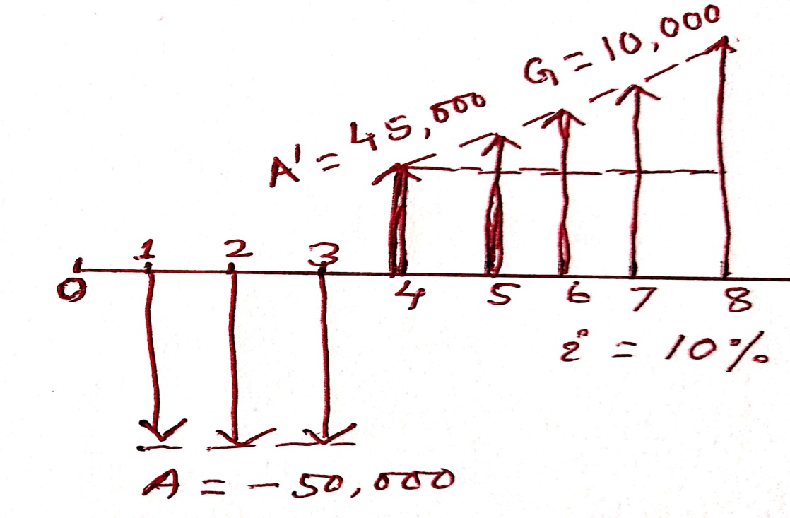
Single Proposal
An Investor can make three end-of-year payments of Rs. 50,000 , which are expected to generate receipts of Rs, 45,000 at the end of year 4 that will increase annually by Rs.10,000 for the following 4 years. If the investor can earn a rate of return of 10 percent on other 8 year investments ,is this alternative attractive

Slide 8
Solution
PW = -50,000 (P/A,10,3) + [45,000 + 10000 (A/G,10,5)](P/A,10,5)(P/F,10,3)
= -50,000 (2.48685) + [45,000 + 10000 (1.81013)](3.79079)(0.75131)
=-124342.5 + [45,000 + 18101.3](3.79079)(0.75131)
=-124342.5 + 63101.3 (3.79079)(0.75131)
=-124342.5 + 179716.189
=55363.689

Slide 9
Mutual Exclusive case (Comparison of assets having equal lives)
 | A | B
Initial Cost | 2300 | 3200
Annual Expenses | 250 | 0
Salvage Value | 0 | 400
Life (N) | 4 | 4
i | 15 %

Slide 10
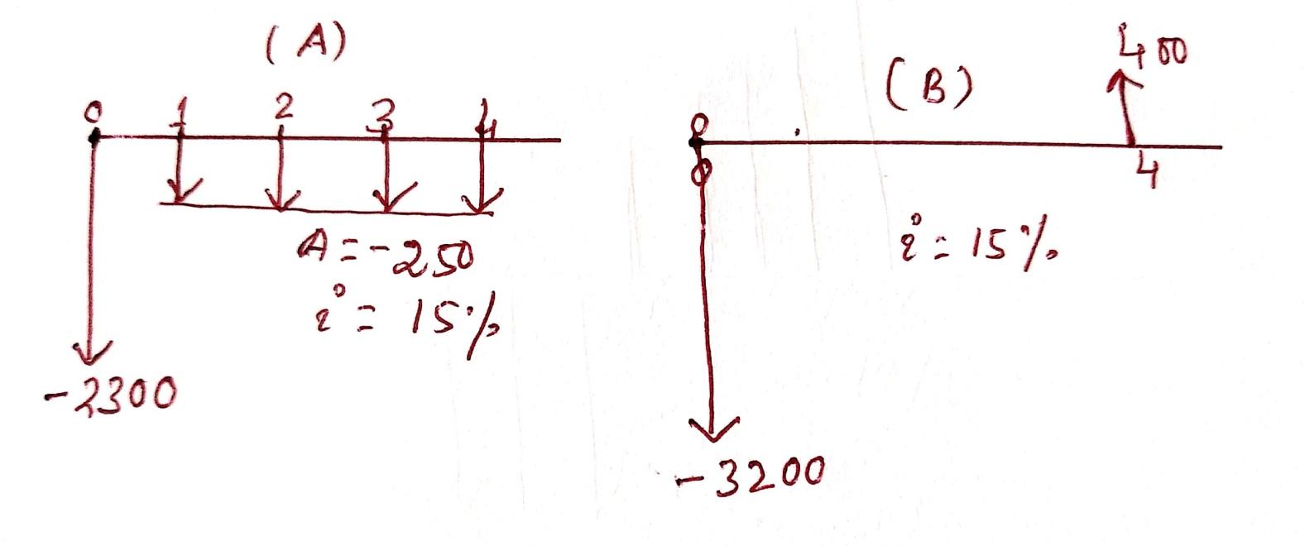

Slide 11
PW (A) = -2300 -250(P/A,15,4)
= -2300 – 250 (2.85498)
= -2300 -250 (2.85498)
= -2300 – 713.745
= -3013.745
PW (B)= -3200 +400 (P/F,15,4)
= -3200 +400 (0.49718)
=-3200 + 198.872
= -3001.128

Slide 12
Comparison Assets having unequal lives
There are two prominent methods to compare the assets having unequal lives.
Common-multiple Method (Repeated Life Method)
In common multiple method we have to select one analysis period for comparing the assets (Common multiple of the lives of the asset involved)
2. Study-period method (Shortest life span)

Slide 13
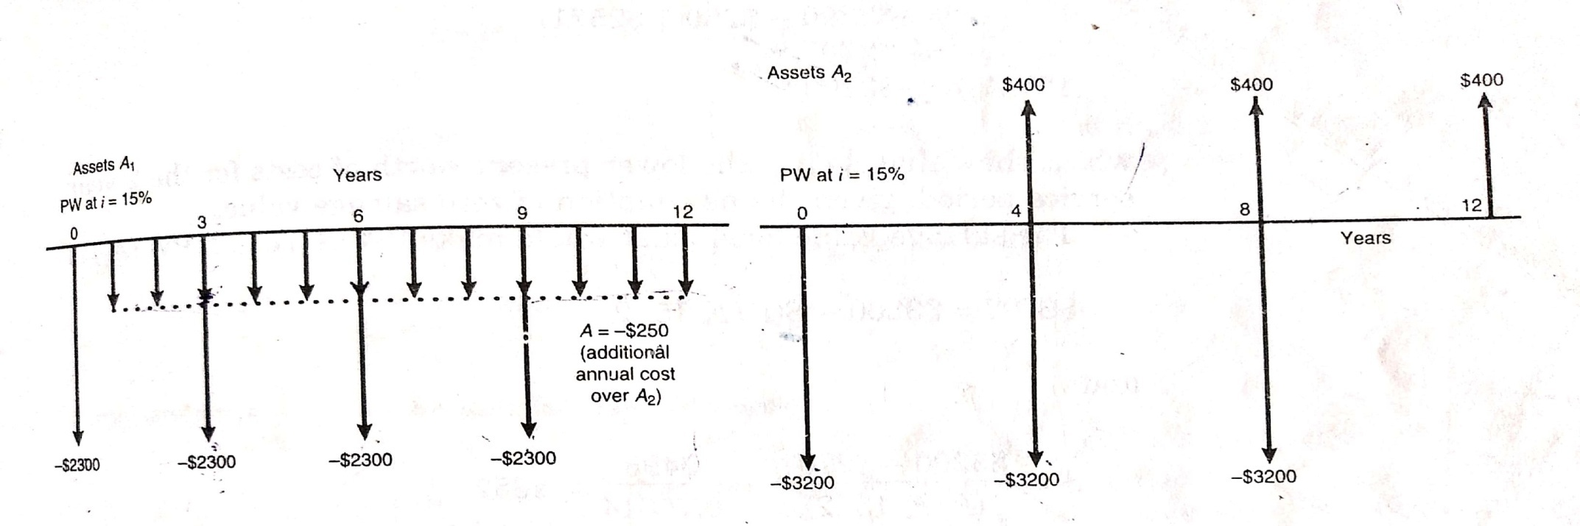
Comparison of Assets having unequal lives (Common-multiple method)
 | A | B
Initial Cost | 2300 | 3200
Annual expenses | 250 | 0
Salvage Value | 0 | 400
Life (N) | 3 | 4
i | 15

Slide 14
PW (A)= -2300 -2300 (P/F,15,3) -2300 (P/F,15,6) -2300 (P/F,15,9) -250 (P/A,15,12)
= -2300 -2300 (0.65752)- 2300 (0.43233)-2300 (0.28426)-250 (5.42062)
= -6816
PW (B) = -3200 -2800 (P/F,15,4)-2800 (P/F,15,8)+ 400 (P/F,15,12)
PW (B) = -3200 -2800 (P/F,15,4) -2800 (P/F,15,8) + 400 (P/F,15,12)
= -3200 -2800 (0.57175) -2800 (0.32691)+ 400 (0.18691)
=-5642

Slide 15
Study Period
Incase of study period method we have to select a common period from both the assets for comparison, we assume we sell the asset at the end of the study period, which results in salvage value of the asset. It may be very difficult to assume the salvage value at the end of the study period. Suppose in this example, we assume the study period is 2 years having no salvage value
PW (A) = -2300 -250(P/A,15,2)
= -2300 -250(1.62571)
=-2707
Pw (B) = -3200
In this case we select A, but the result contradict. The reason is salvage value that was present in the original question.
Suppose now we want to bring back salvage value to B after two years and what should be the salvage of B, if we want to select B again

Slide 16
2707= 3200 –S(P/F,15,2)
S = 3200-2707(P/F,15,2= 493/0.75614= 652

Slide 17
Comparison of Assets having infinite lives
The sum of the first cost and the present –worth of disbursements last forever is called a capitalized cost

Slide 18
You are given Rs. 10,00,000 by your institute for the opening and upkeep of a music cell in your campus. Annual maintenance of the music cell is expected to be Rs. 25,000. You also need Rs. 1,00,000 in every 10 years for major equipments purchase. How much will be left for the initial opening costs ,after funds are allocated for perpetual upkeep? Deposited funds can earn 7 percent annual interest .

Slide 19
Future-worth Comparison
Net present worth measures the surplus in an investment project at time 0
Net future worth is a particularly useful investment situation where we need to compute the equivalent worth of a project at the end of its investment period, rather than it’s beginning
Single proposal
If FW (i)>0, accept the investment
If FW (i)=0 remain indifferent to investment
If FW (i)<0, reject the investment

Slide 20
Find the Future-worth of the cash-flow diagram given below.
FW=50,000(F/A,10,3)(F/P,10,5)+[45,000+10,000(A/G,10,5)(F/A,10,5)

Slide 21
Pay-back Period Comparison
The pay-back method is otherwise known as the pay out method
It is used to obtain a rough estimate of the time that an investment will take to pay for itself
Conventional payback period method: The simplest method. Ignores the time value of money
Discounted payback period method: It includes the time value of money; it is more complex to conduct that method

Slide 22
End of year | A | B | C
0 | -1000 | -1000 | -700
1 | 500 | 200 | -300
2 | 300 | 300 | 500
3 | 200 | 500 | 500
4 | 200 | 1000 | 0
5 | 200 | 2000 | 0
6 | 200 | 4000 | 0

Slide 23
A company is considering an investment in a project that requires an initial outlay of₹100,000. The project will generate the following cash flows over the next five years:
Year 1:₹30,000
Year 2:₹35,000
Year 3:₹40,000
Year 4:₹45,000
Year 5:₹50,000
The company's required rate of return is 8%. What is the discounted payback period for this investment?

Slide 24
Problems
If Utkal limited expects cash inflows from its investment proposal it has undertaken in time period zero, Rs 2,00,000 and Rs 1,50,000 for the second year and than expects annuity payment of Rs 1,00,000 for the next eight years, what would be the present value of cash inflows , assuming a ten percent rate of interest?

Slide 25
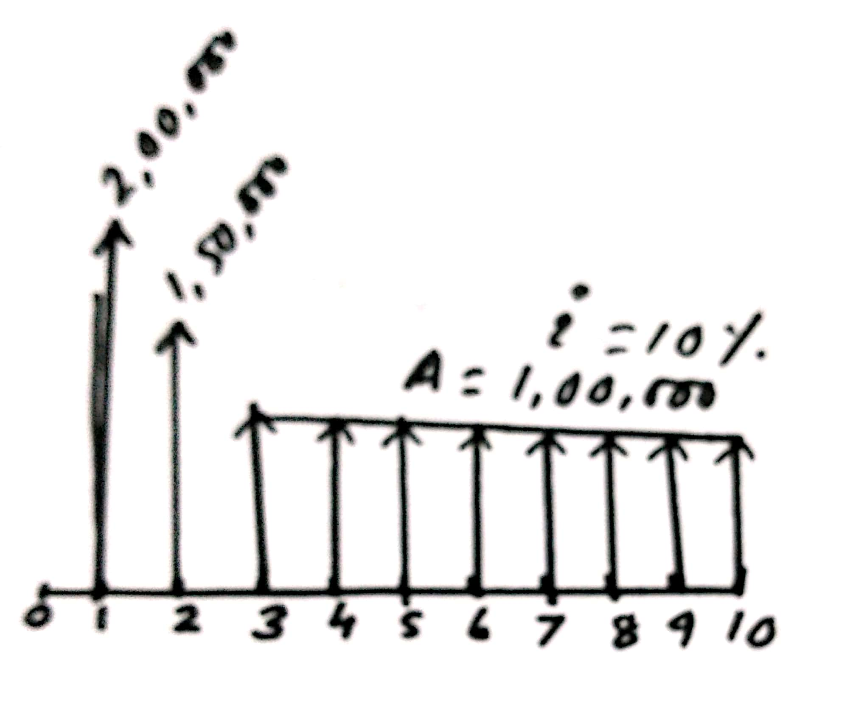
PW = 2,00,000 (P/F,10,1) +150000(P/F,10,2)+100000(P/A,10,8)(P/F,10,2)
PW = 2,00,000 (0.90909) +150000(0.82645)+100000(5.33493)(0.82645)
PW= 181818+123967.5+440905.289
PW=746690.789

Slide 26
Mr. Patnaik has ten more years of service .He is planning for his retired life. He would like to deposit Rs 8500 in the first year and thereafter he wants deposit the amount with an annual decrease of Rs 500 for the next 9 years with an interest rate of 15%. Find the total amount at the end of 10th year of the above series

Slide 27
A’= 8500, G=500, N=10, i=10% F=?
A= 8500-500 (A/G,10,10)
= 8500 -500(3.72546)
= 8500 -1862.73=6637.27
6637.27(F/A,10,10)
= 6637.27(15.93742)
= 105780.959

Slide 28
An investor has an option to purchase a tract of land that will be worth Rs. 10,000 in six years. If the value of the land increases at 8% each year, how much should the investor be willing to pay now for this property?

Slide 29
F= 10000 , N=6 , i=8%, P= ?
P = 10000 (P/F,8,6)
= 10000 (0.63017)
=6301.7

Slide 30
A proposed improvement in an assembly line will have an initial purchase and installation cost of Rs. 1,75,000.The annual maintenance cost will be Rs 6000; periodic overhauls once every three years excluding the last year of use, will cost Rs 11,500 each. The improvement will have a useful life of 9 years at which time it will have no salvage value. What is the present worth of the 9 year cost of the improvement at i = 8 percent.

Slide 31
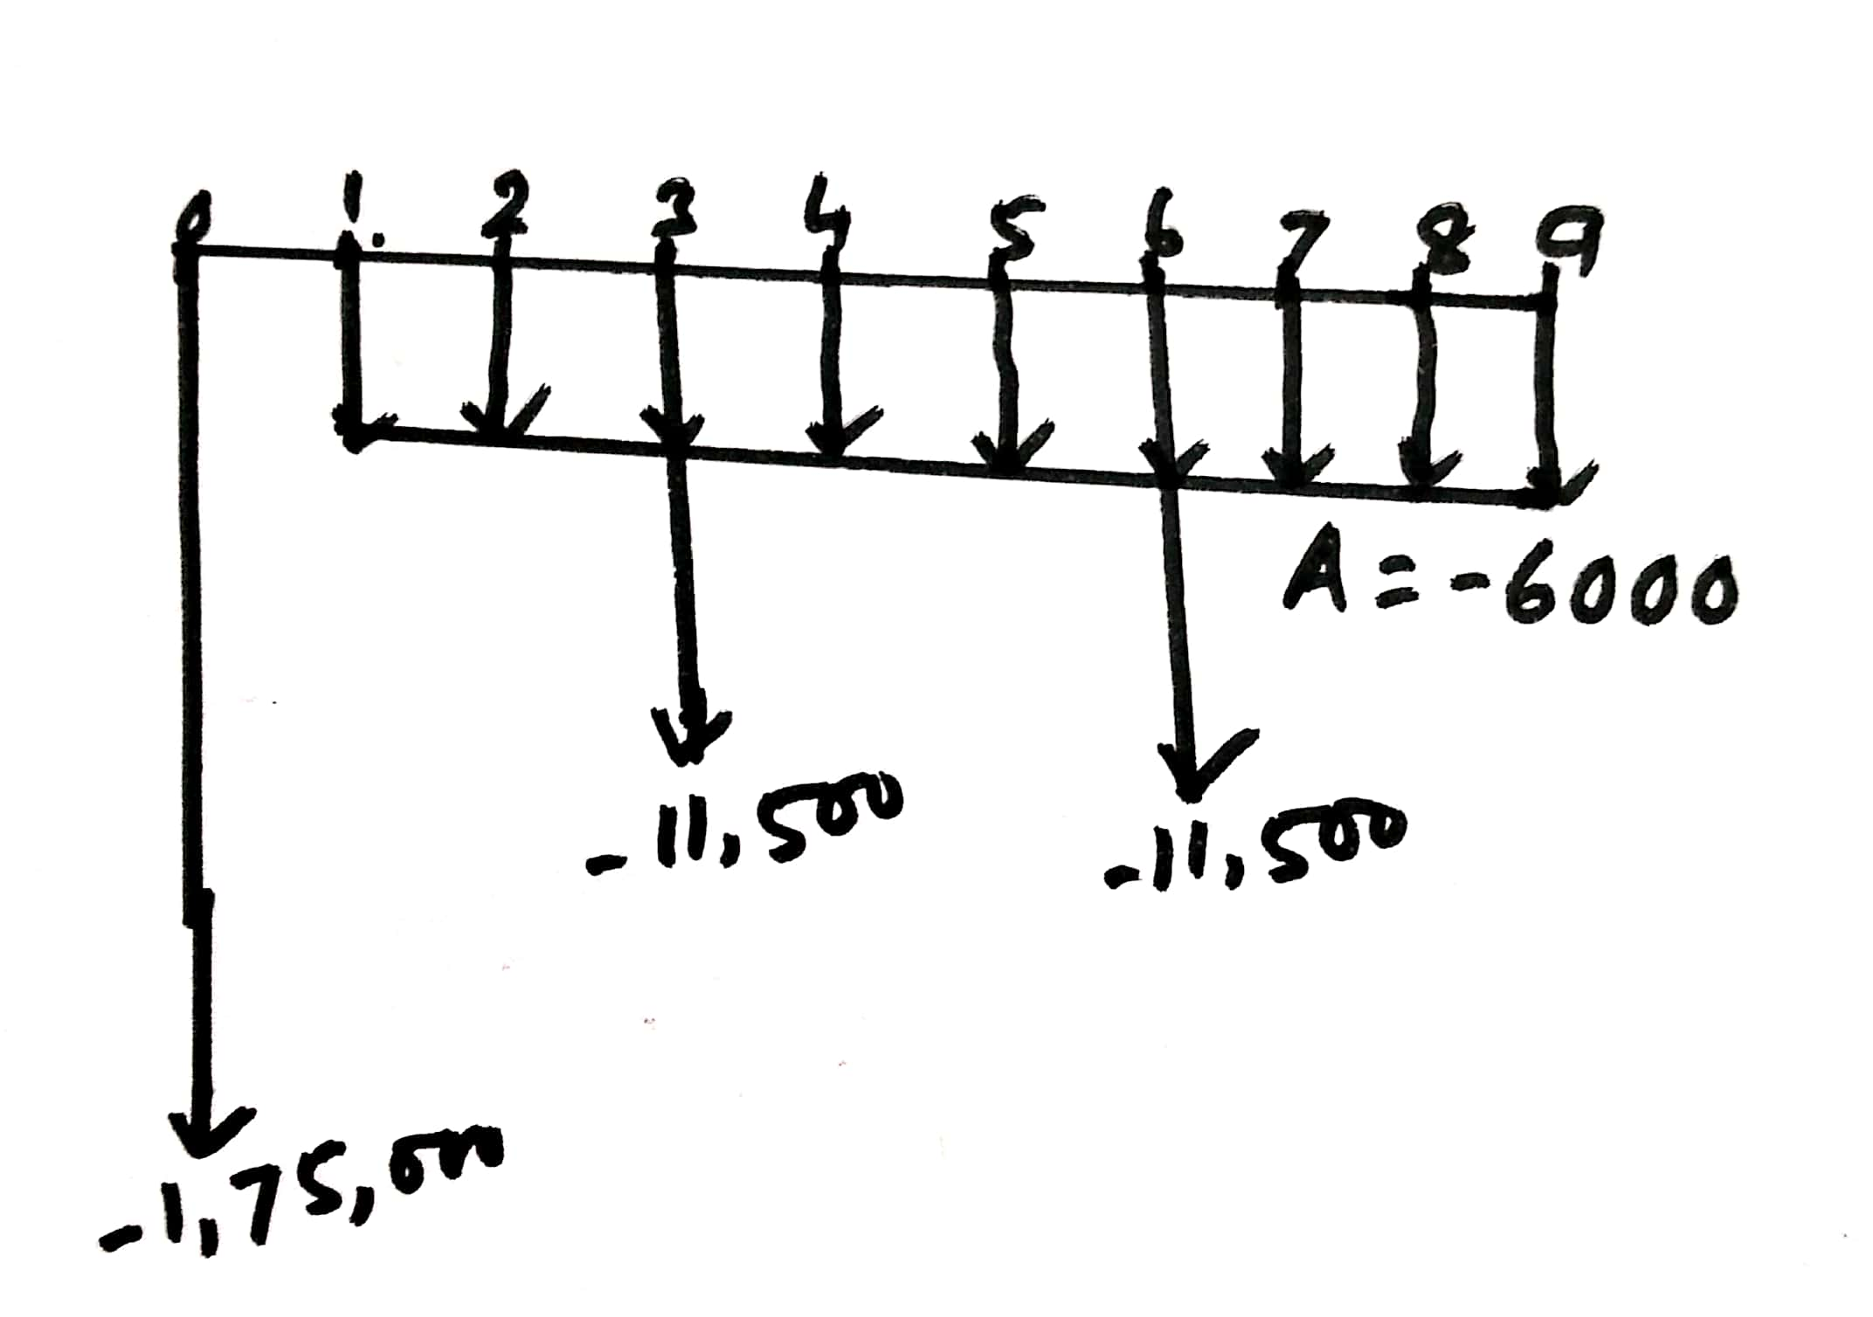
PW (Cost) = 175000 + 11,500(P/F,8,3) +11500 (P/F,8,6) + 6000 (P/A,8,9)
= 175000 + 11,500(0.79383) +11500 (0.63017) + 6000 (6.24689)
= 175000 + 9129.045+7246.955 +37481.34
=228857.34

Slide 32
A refinery company entered in to a contract for raw materials with an agreement to pay Rs 6,00,000 now and Rs 1,50,000 per year beginning at the end of the fifth year. The contract was made for 10 years. At the end of the third year, because of unexpected profits , the company requested that it will be allowed to make a lump sum payment in advance for the rest of the contract. Both parties agreed that 7 percent compounded annually was a fair interest rate. What was the amount of lump sum?

Slide 33
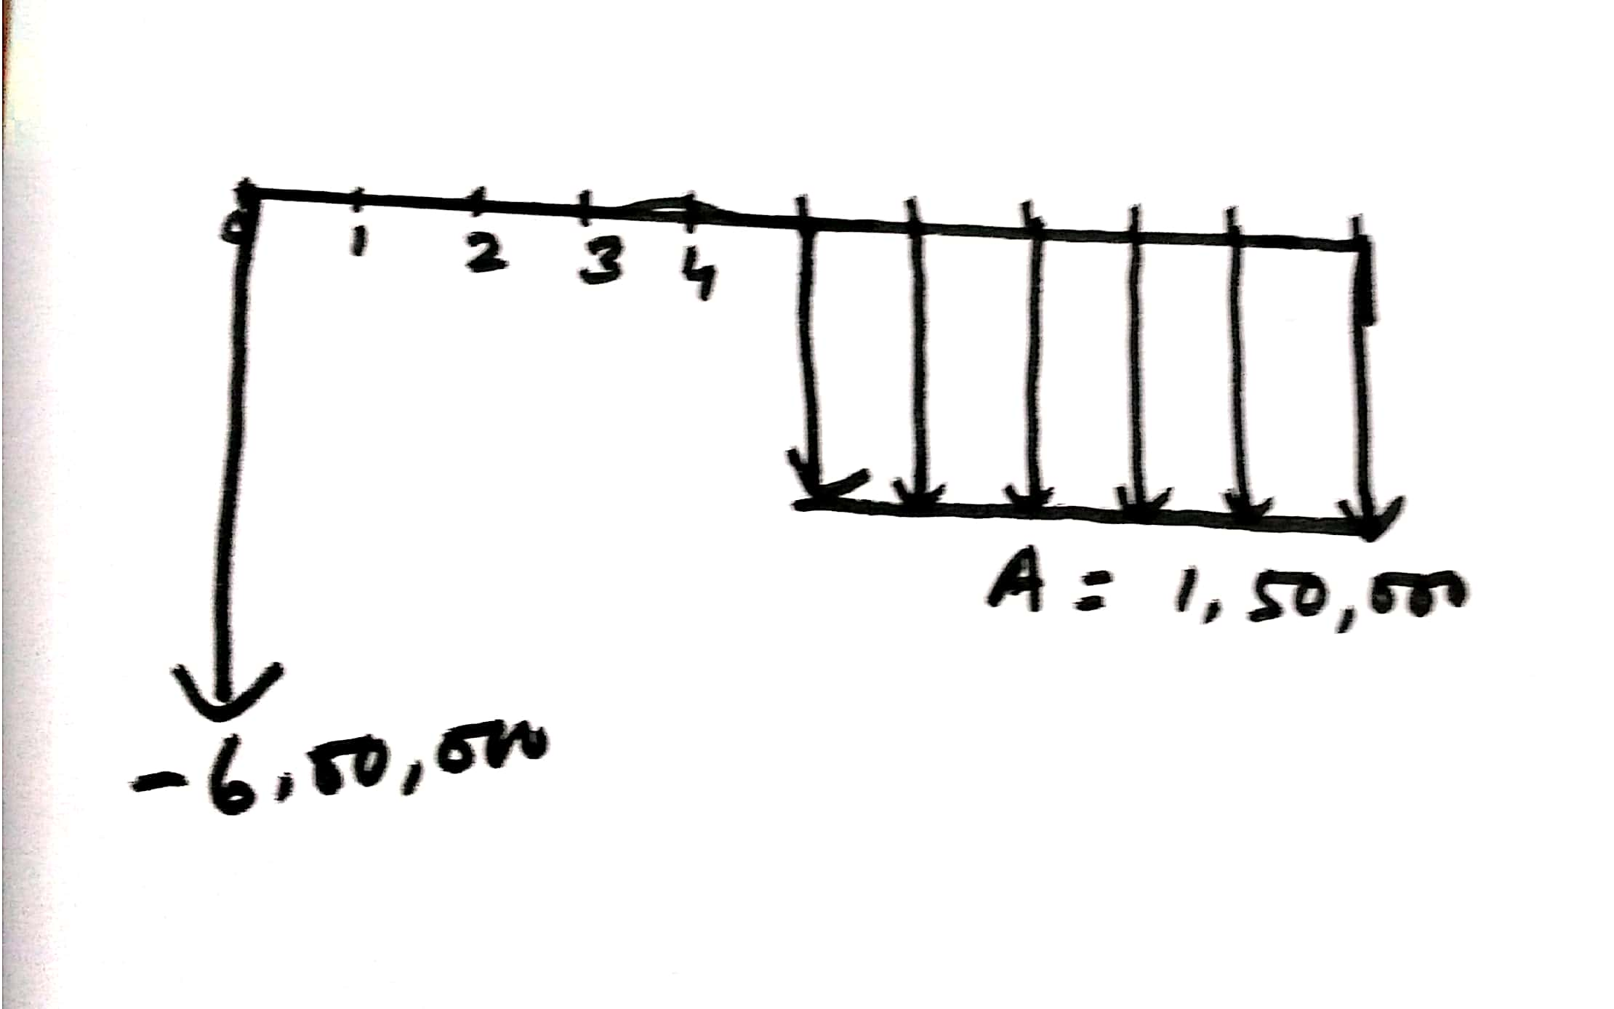
PW = 1,50,000 (P/A,7,6) (P/F,7,1)
= 150000(4.10020)(0.93458)
= 574794.737

Slide 34
A company wants to set up a reserve which will help the company to have an annual equivalent amount of Rs 10,00,000 for the next 20 years towards employees welfare measures. The reserves assumed to grow at the rate of 15 percent annually. Find the single payment that must be made now as the reserve amount.

Slide 35
PW = 1000000(P/A,15,20)
=1000000(6.25933)
=6259330

Slide 36
Mrs. Sabitri Rao Invests a sum of Rs. 50,000 in a bank at a nominal rate of interest of 18% for 15 years. The compounding is done half yearly. Find the maturity amount.

Slide 37
P =50,000 i=9% N= 30
F = 50000 (F/P,9,30)
50000(66.21177)
=3310588.5

Slide 38
A company wants to buy a machine. It has received two offers. The details are as under
At 10% interest rate, which offer should be selected. Use Future worth Method.
Initial Cost | Rs.6,00,000 | Rs,8,00,000
Life Span | 4 years | 4 years
Salvage Value | Rs. 1,00,000 | Rs. 1,00,000
Annual maintenance cost | Rs.50,000 | Nil

Slide 39
FW (A)=-600000(F/P,10,4) +100000-50000(F/A,10,4)
FW (A)=-600000(1.46410) +100000-50000(4.64100)
FW (A) = -878460+ 100000-232050
FW(A)= -1010510
FW (B) = -800000 (F/P,10,4) +100000
FW (B) = -800000 (1.46410) +100000
FW (B) = -1071280

Slide 40
A marina has two alternative plan for constructing a small-boat landing on lake behind the sales building, one is a wooden dock and the other is a metal and concrete wharf. Data for the two plans are as shown. Using a minimum rate of return of 10 percent compare the present worth of the two plans.
 | Wood | Metal and Concrete
First Cost | 35,000 | 55,000
Period before Replacement | 10 years | 15years
Salvage value | 5000 | 0
Annual maintenance | 6000 | 3200

Slide 41
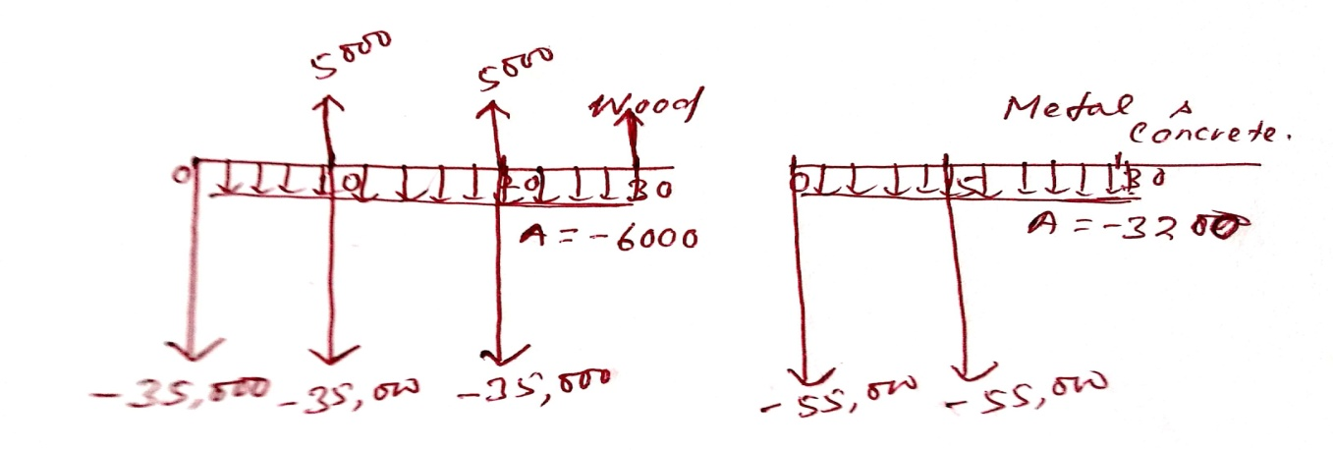
PW = -35,000 -30,000 (P/F,10,10) - 30,000(P/F,10,20) +5000(P/F,10,30)-6000(P/A,10,30)
PW(W) = -35,000 -30,000 (0.38554) - 30,000(0.14864) +5000(0.055731)-6000(9.42691)
PW(W) = -35,000 -11566.2 – 4459.3 +278.655-56561.46
PW= -107308.305
PW(M) = -55,000 -55,000(0.23939) -3200(9.42691)
PW (M) = -55,000 -13166.45 -30166.112
PW(M)= -98332.562

Slide 42
A finance company advertises two investment plans. In Plan-I, The Company pays Rs. 12,000 after 15 years for every Rs 1,000 invested now. In plan-II, for every Rs. 1000 invested the company pays Rs. 4000 at the end of 10th year and Rs. 4000 at the end of 15th year. Select the best alternative plan for the investors point of view at i = 12% compounded annually.

Slide 43
FW(I) = -1000 (F/P,15,12) + 12,000
FW(I) = -1000 (5.35025) + 12,000
FW(I) = -5350.25 +12000
= 6649.75
FW(II) = -1000 (5.35025) + 4000 (2.01136) + 4000
= -5350.25 + 8045.44 +4000
= -5350.25+ 12045.44
=6695.19

Slide 44
A proposed mill in an isolated area can be furnished with power and water by a gravity feed system. A stream high above the mill will be tapped to provide flow for water needs and power requirements by connecting it to the mill with a ditch-and -tunnel system or with a wood-and-concrete flume that winds its way down from the plateau. Either alternative will meet current and future needs, and both will utilise the same power-generating equipment.
The ditch-and-tunnel system will cost Rs. 5, 00,000 with an annual maintenance cost of Rs. 2000. The flume has an initial cost of Rs. 2, 00,000 and a yearly maintenance cost of Rs. 12,000. In addition, the wood portion of the flume will have to be replaced every ten years at a cost of Rs.1, 00,000.
Compare the alternative on the basis of capitalised costs with an interest rate of 6 per cent.

